Slide 1
Get Set Up
Follow this link:
https://github.com/sdac-vt/Ranking-Workshop-2021
Open the notebook to follow along
Please open and set up a few things on your computer to follow along!
Notes:
https://colab.research.google.com/drive/196SL5nKPHkqhgM2UfmHMcoh56frDNQi5?usp=sharing

Slide 2
Rating and Ranking Sports Teams
Who’s #1? The Science of Rating and Ranking
by Amy N. Langville and Carl D. Meyer

Slide 3
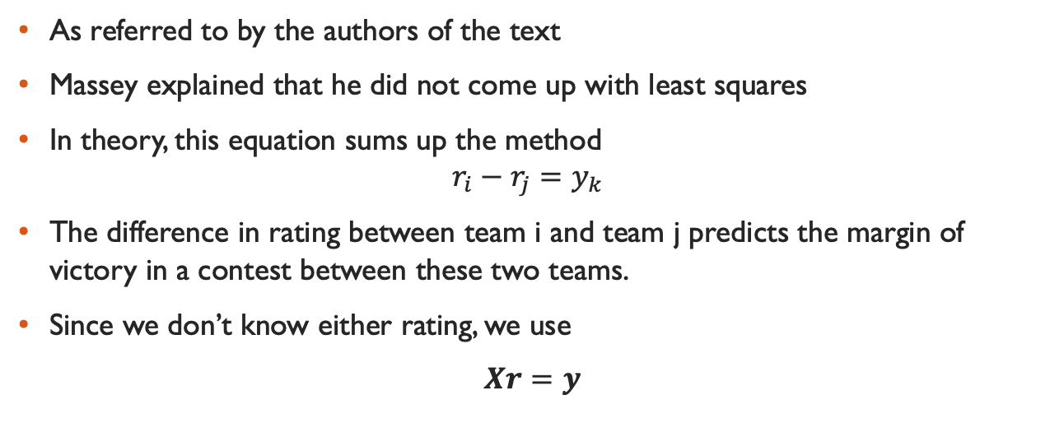
”Massey’s Method”
As referred to by the authors of the text
Massey explained that he did not come up with least squares
In theory, this equation sums up the method
$$r_{i}−r_{j}=y_{k}$$
The difference in rating between team i and team j predicts the margin of victory in a contest between these two teams.
Since we don’t know either rating, we use
$Xr=y$

Slide 4
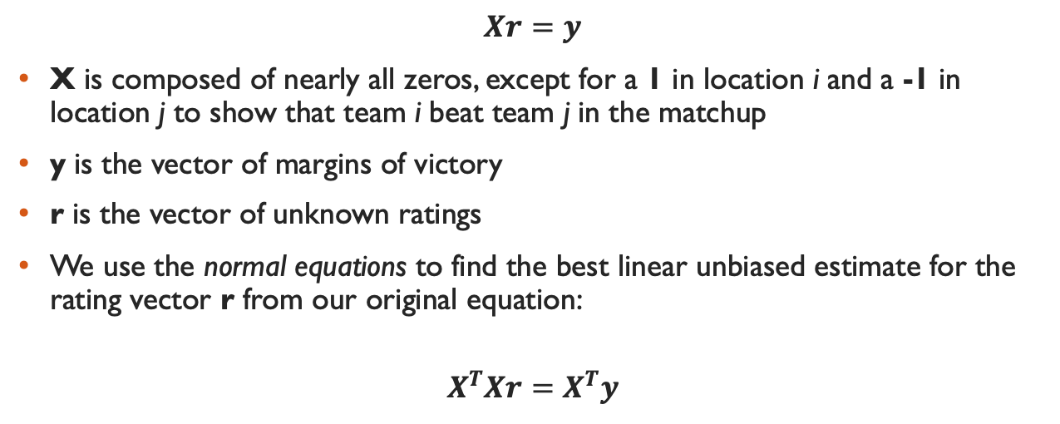
“Massey’s method”
$$Xr=y$$
X is composed of nearly all zeros, except for a 1 in location i and a -1 in location j to show that team i beat team j in the matchup
y is the vector of margins of victory
r is the vector of unknown ratings
We use the normal equations to find the best linear unbiased estimate for the rating vector r from our original equation:
$$X^{T}Xr=X^{T}y$$

Slide 5
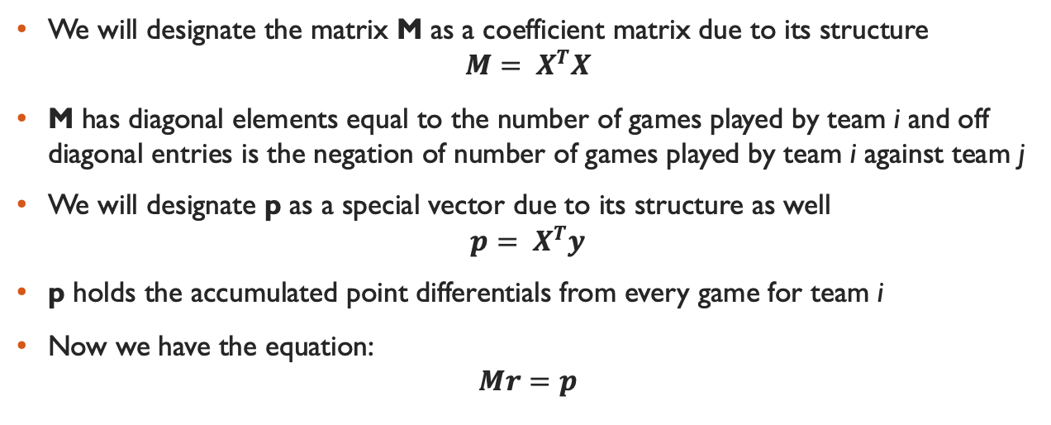
“Massey’s method”
We will designate the matrix M as a coefficient matrix due to its structure
$$M= X^{T}X$$
M has diagonal elements equal to the number of games played by team i and off diagonal entries is the negation of number of games played by team i against team j
We will designate p as a special vector due to its structure as well
$$p= X^{T}y$$
p holds the accumulated point differentials from every game for team i
Now we have the equation:
$$Mr=p$$

Slide 6
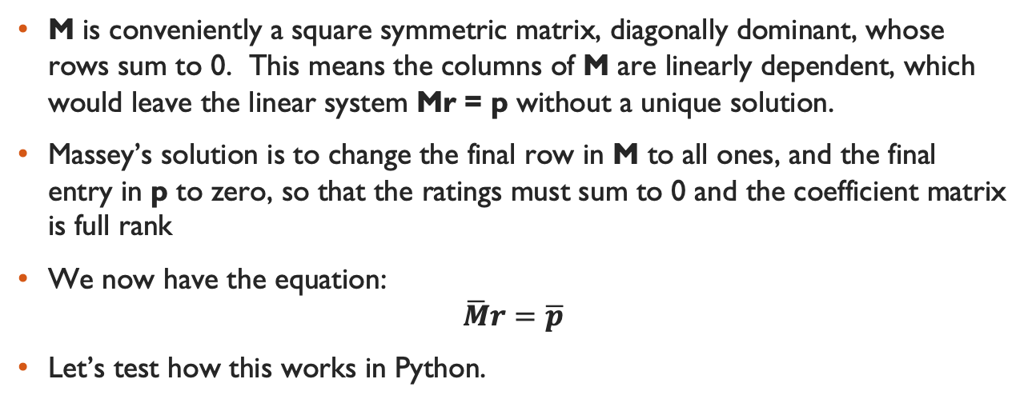
“Massey’s Method”
M is conveniently a square symmetric matrix, diagonally dominant, whose rows sum to 0. This means the columns of M are linearly dependent, which would leave the linear system Mr = p without a unique solution.
Massey’s solution is to change the final row in M to all ones, and the final entry in p to zero, so that the ratings must sum to 0 and the coefficient matrix is full rank
We now have the equation:
$$\overline{M}r=\overline{p}$$
Let’s test how this works in Python.

Slide 7
Get Set Up
Follow this link:
https://github.com/sdac-vt/Ranking-Workshop-2021
Open the notebook to follow along
While you get seated please open and set up a few things on your computer to follow along!
Notes:
https://colab.research.google.com/drive/196SL5nKPHkqhgM2UfmHMcoh56frDNQi5?usp=sharing

Slide 8
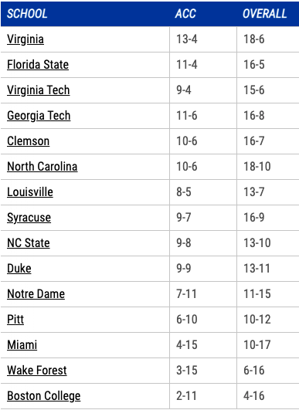
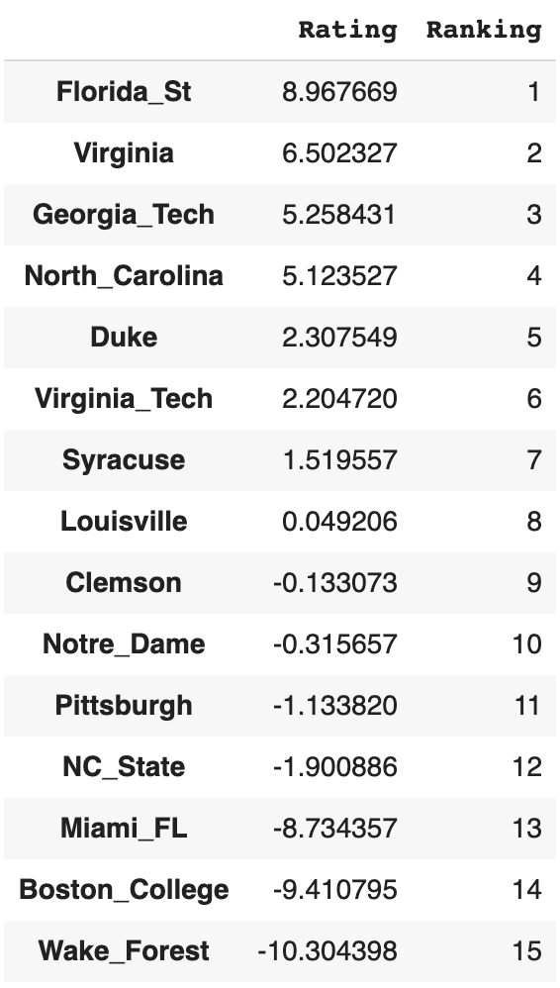
ACC Standings vs our Ranking

Slide 9
ACC Standings vs our Ranking
+/-
+1
-1
+1
+2
+5
-3
+1
-1
-4
+1
+1
-3
0
0
0

Slide 10
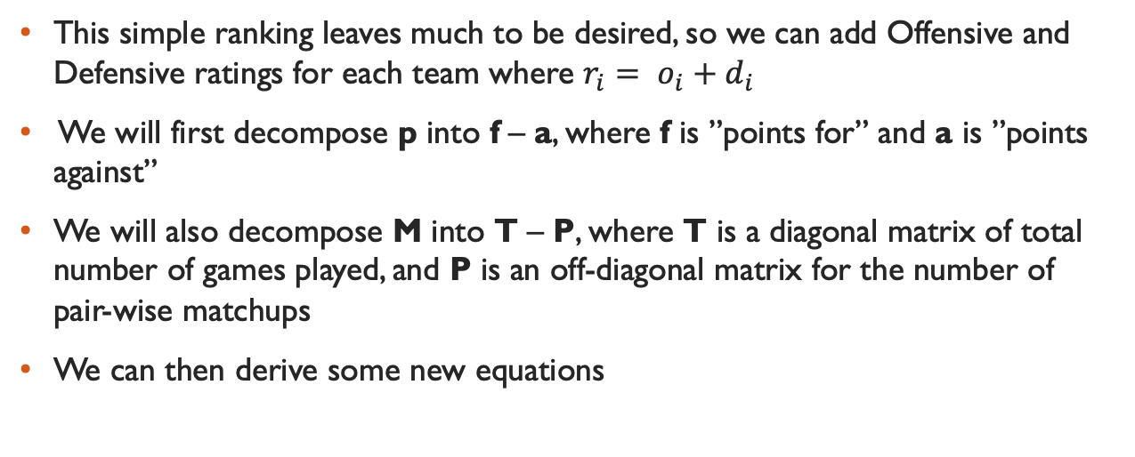
Adding Offense and Defense
This simple ranking leaves much to be desired, so we can add Offensive and Defensive ratings for each team where $r_{i}= o_{i}+d_{i}$
We will first decompose p into f – a, where f is ”points for” and a is ”points against”
We will also decompose M into T – P, where T is a diagonal matrix of total number of games played, and P is an off-diagonal matrix for the number of pair-wise matchups
We can then derive some new equations

Slide 11
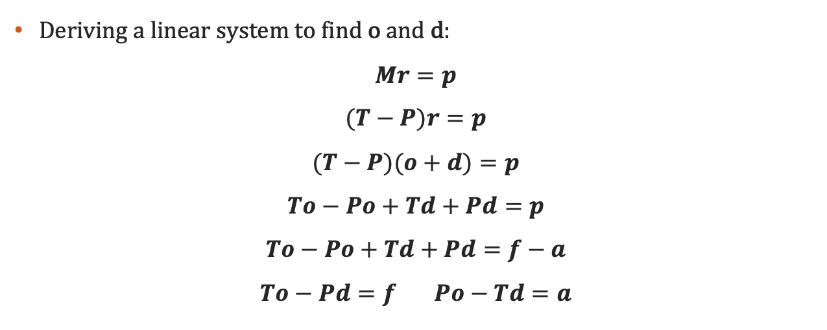
Adding Offense and Defense
Deriving a linear system to find o and d:
$$Mr=p$$
$$(T−P)r=p$$
$$(T−P)(o+d)=p$$
$$To−Po+Td+Pd=p$$
$$To−Po+Td+Pd=f−a$$
$$To−Pd=f Po−Td=a$$

Slide 12
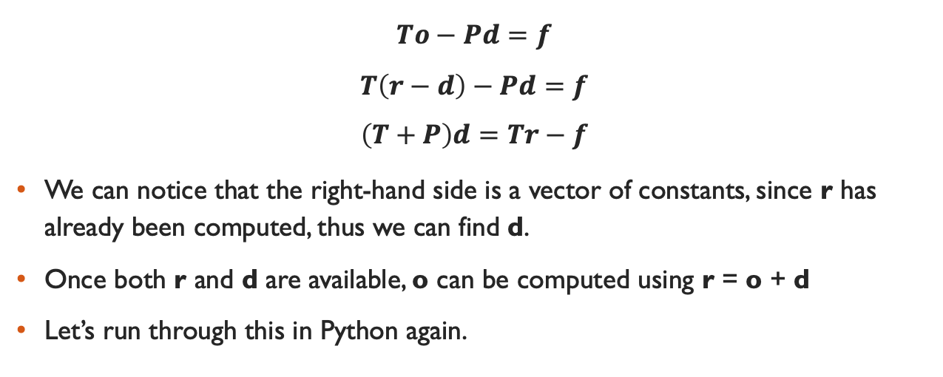
Adding Offense and Defense
$$To−Pd=f$$
$$T\left(r−d\right)−Pd=f$$
$$\left(T+P\right)d=Tr−f$$
We can notice that the right-hand side is a vector of constants, since r has already been computed, thus we can find d.
Once both r and d are available, o can be computed using r = o + d
Let’s run through this in Python again.

Slide 13
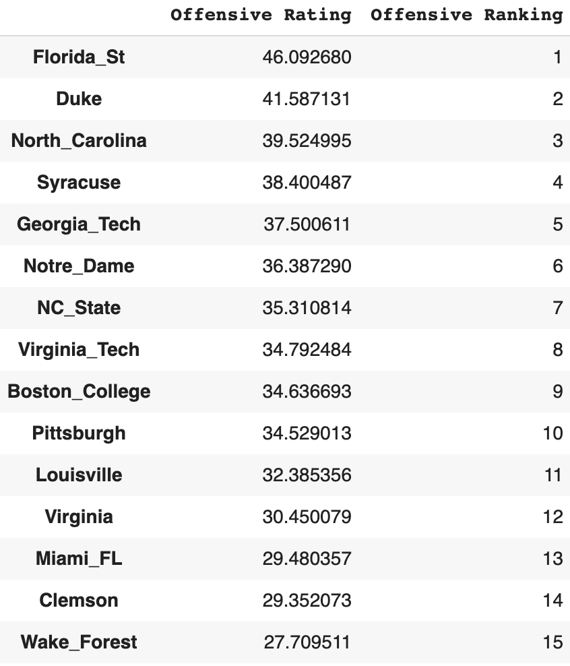
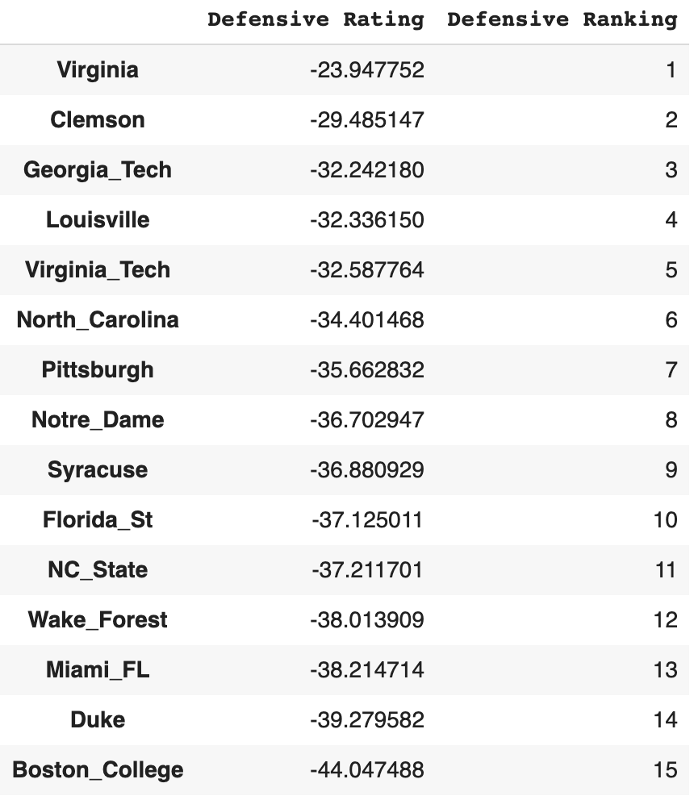
Offensive and Defensive Ratings

Slide 14
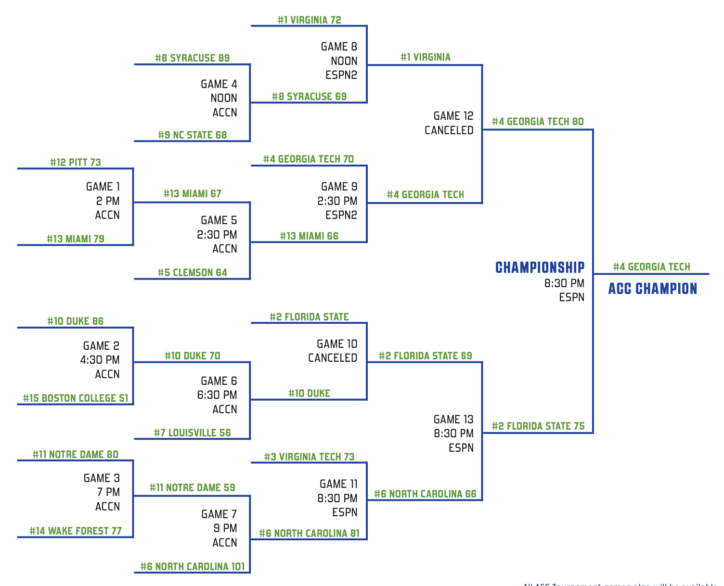
Can we predict the Outcome of the Acc Tournament this way?

Slide 15
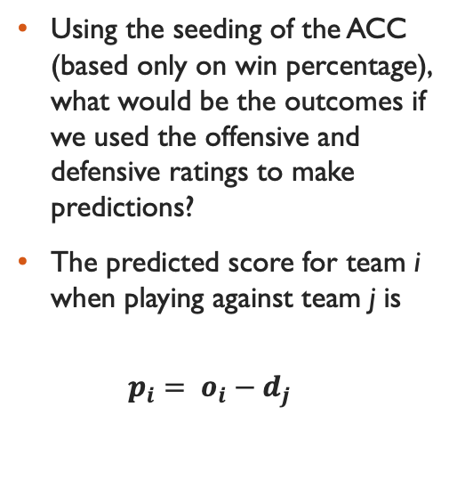
Can we predict the Outcome of the Acc Tournament this way?
Using the seeding of the ACC (based only on win percentage), what would be the outcomes if we used the offensive and defensive ratings to make predictions?
The predicted score for team i when playing against team j is
$$p_{i}= o_{i}−d_{j}$$

Slide 16
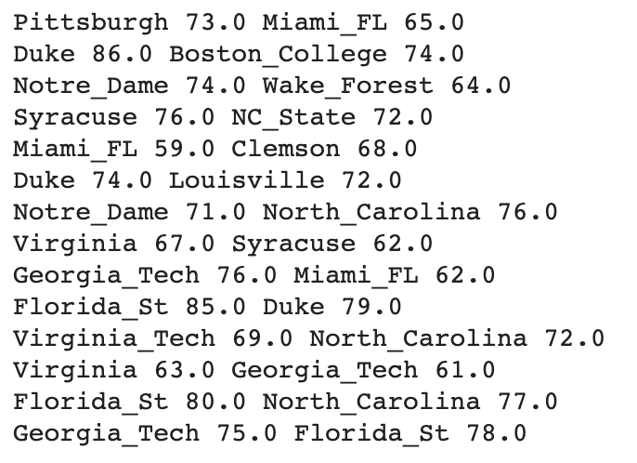
Can we predict the Outcome of the Acc Tournament this way?
Acc.
0
1
1
1
0
1
1
1
1
-
1
-
1
0
75%

Slide 17
Good Luck!
Code: https://github.com/sdac-vt/Ranking-Workshop-2021
Data: https://www.masseyratings.com/scores

